Slide 1
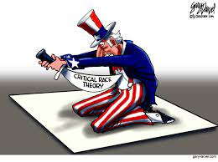
Critical Race Theory (CRT):
The “New, Improved” Racism
Since the old racism didn’t succeed in
destroying the country, let’s “try, try again”!

Slide 2
Table of Contents
1. The "new, improved" Marxism (3)
1a. Marxism's disaster: Fall of the USSR, 1989 (3)
1b. CRT: A "new, improved" Marxist class warfare - made in America! (4-5)
2. What is CRT? (6)
2a. Five core tenets (6)
2b. Two absurd CRT assumptions (7)
2c. CRT's wrong diagnoses/remedies for today's evils (8-9)
2d. CRT buzzwords: What they really mean (10-11)
3. “New, improved” Ku Klux Klan? (12)
3a. BLM, CRT and Marxism are inseparable (12)
3b. CRT/BLM should remind us of the KKK (13)
4. Halting CRT (14)
4a. Why is opposition so ineffective? (14)
4b. Three successful anti-CRT strategies (15-17)
5. CRT is stupid! How did it ever thrive?? (18-19)
6. Divine judgment and repentance (20)
6a. A sinful, wicked nation (20)
6b. Judgment on a wicked nation (21)
6c. Repentance and restoration (22)

Slide 3
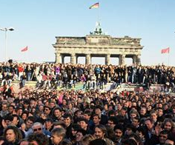
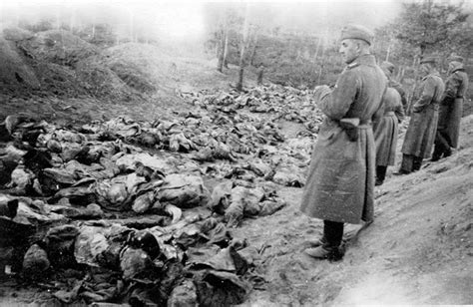
1. The "new, improved" Marxism
1a. Marxism's worst disaster: Fall of the USSR, 1989
Mass murder by Soviet NKVD police, 1940
Ecstasy when Berlin Wall fell, 1989
Over 94 million murdered under Communism

Slide 4
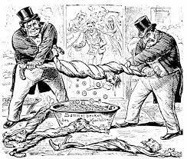
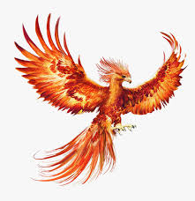
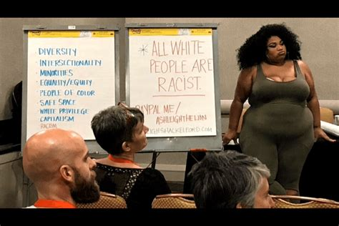
1b. CRT: A "new, improved" class warfare - made in America! (1)
19th-20th Century Marxism:
Class struggle (failed)
Marxist chimera rising from
the 1989 ashes
21st Century American Marxism:
Racial struggle (among others)
“There is nothing new under the sun” (Ecclesiastes 1:9)

Slide 5
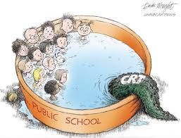
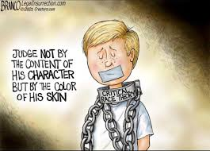
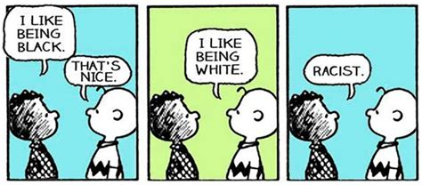
“Originally, the Marxist left built its political program on the theory of class conflict…
“Abandoning Marx’s economic dialectic of capitalists and workers, they substituted race for class and sought to create a revolutionary coalition of the dispossessed based on racial and ethnic categories…
“CRT is an academic discipline, formulated in the 1990s and built on the intellectual framework of identity-based Marxism…”
Christopher F. Rufo, Senior fellow and director of the initiative on CRT at the Manhattan Institute https://nypost.com/2021/05/06/what-critical-race-theory-is-really-about/
1b. CRT: A "new, improved" class warfare - made in America! (2)

Slide 6
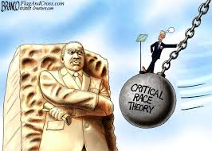
2. What is CRT?
2a. Five core tenets
1. Race is a social construct: Not connected
to biology
2. Racism is systemic: Not just the actions
of a few “bad apples”; it permeates culture, society, and our legal system – but will
anyone give any specifics?
3. Social Justice: Outcome inequality is “racist”; more people of color are poor
- Ignores other causes : IQ, inadequate diet, fatherless boys, high illegitimacy)
- Since “The poor you always have with you” (John 12:8), activists can always mess with the institutions.
4. The Importance of “Life Stories”
- Stories are important, but CRT is highly
selective: Omit Clarence Thomas, Mark Robinson, the Good Samaritan
5. Interdisciplinary Perspective: Get CRT’s tentacles into all academic disciplines
Trashes the civil rights movement
Notes:
Learn more
Learn more about legacy of racism (blacks couldn’t buy houses when they were cheap)
No father in the home; the Bible repeatedly talks of the disparity of a fatherless child brought up by a widow. How much more when the mother became pregnant by a “father” who never intended to take any responsibility for the household?
4. Very selective in the narratives they pick. What about Clarence Thomas? Mark Robinson? Poor whites who are still considered the “

Slide 7
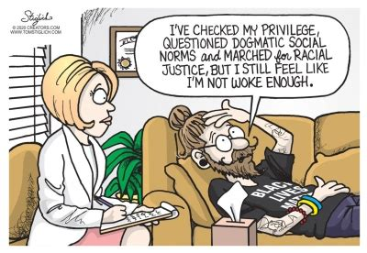
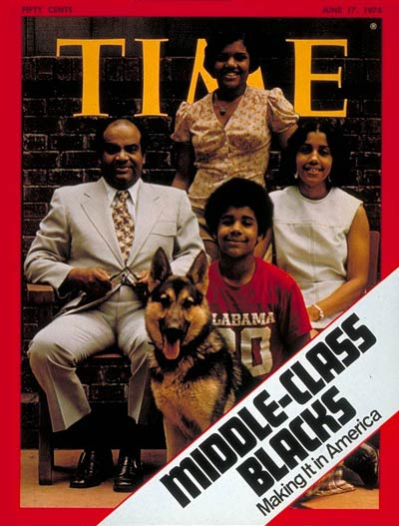
1. All whites are despised oppressors – the new racism
- Even impoverished whites are “oppressors”
- Denial by white of “racism” only proves their “racism”
- No redemption: Whites may only grovel, self-flagellate, and denigrate other whites who refuse to admit their “racism”
2. All “people of color” are “oppressed victims” of “systemic racism” who can’t succeed
- Racial disparity “proves” systemic racism (post hoc ergo propter hoc fallacy)
- Lies to and insults poor people of color
- Why are there so many “oppressed” black sports, rock, and political icons?
- Why the sizeable black and Hispanic middle classes?
- Why are East Asian Americans (from China, Japan) better off than whites, despite their past racial oppression?
2b. Two absurd CRT assumptions
June 17, 1974

Slide 8
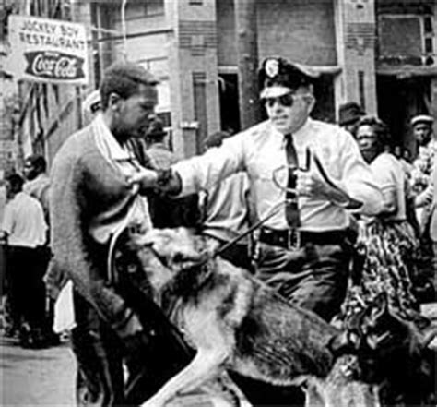
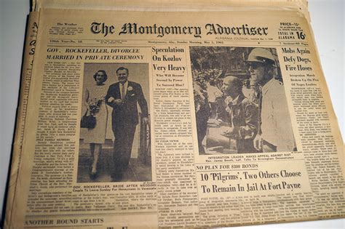
2c. CRT's wrong “diagnoses/remedies” for today's evils (1)
Knowing America’s true racist past and how it affects us today helps us better know CRT’s false “diagnoses” and “remedies”.
Three truths peculiar to America give CRT powerful leverage
1. Racism is America was wicked
CRT falsehood: “Systemic racism”
2. Racist police were wicked
CRT falsehood: The police haven’t changed; defund them
3. Collective guilt is real (Exodus 20:5-6)
CRT falsehood: Only whites have collective guilt; what about black Africans who sold fellow blacks into slavery?
4. Real evil: Antagonisms (class, occupation,
racial, etc.) go back to Genesis 43:32, 46:34
CRT falsehood: Recognize only certain antagonisms, ignore others; resolves nothing (cf. Matthew 5:9)

Slide 9
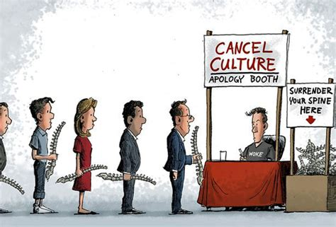
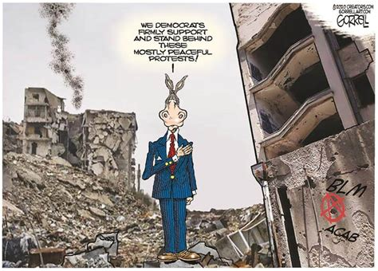
2c. CRT's wrong diagnoses/remedies for today's evils (2)
5. Real evil: Every person is flawed (Genesis 6:5), and all need the Gospel’s redemption (Acts 4:12, Galatians 3:28)
CRT falsehood: All whites are evil and unredeemable
6. Real evil: Racists include people of all races
CRT falsehood: Only whites, and all of them, are racists
7. Real evil: Our racist past adversely affects the country today
Exaggerate lingering racism;
Invent racism out of whole cloth;
Ignite a new interracial hatred to replace the real racism;
blacks and whites worked together so hard to neutralize
Destroy the “racist” structures whites created
Gullible whites
CRT Anti-racism

Slide 10
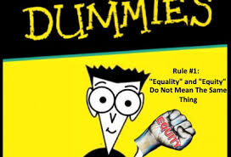

2d. CRT buzzwords: What they really mean (1)
1. Equity vs. Equality: Equity = equality of outcome.
Any inequality of outcome is due to “systemic racism“ and must be forcefully addressed
- Equality of opportunity is now “racist”
- Unceasing excuses for government coercion
2. Social Justice vs Justice: Social justice = “Justice in terms of the distribution of wealth, opportunities, and privileges within a society” (Oxford Languages Dictionary).
Equal protection of the law (14th Amendment) is now evil
3. Diversity and Inclusion: All groups must be represented in the workplace, etc.
Diversity of skills, talent are vastly de-emphasized
Equity is NOT equality!
Poor men can’t hire you!

Slide 11
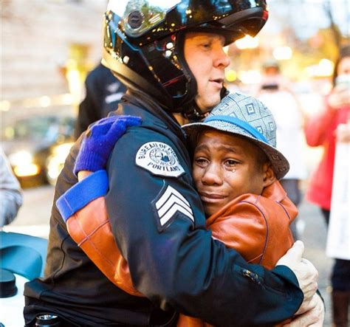
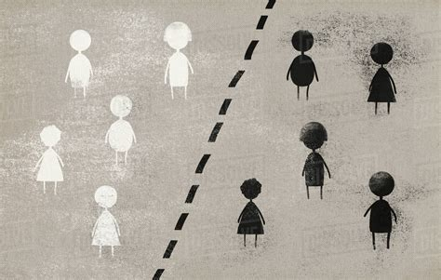

4. Culturally Responsive Teaching (CRTa) a Trojan horse for Critical Race Theory (CRTb)
Knowledge of a child’s racial background (CRTa) will obviously help teach, as long as it is not an excuse to sneak in Critical Race Theory (CRT-b)
5. Anti-racism: Destroy “racist” structures and institutions (clever word; who could be against racism?) vs. “Love your neighbor as yourself”, regardless of who he is (see Luke 10:25-37, the Good Samaritan story)
2c. CRT buzzwords: What they really mean (2)
NOT
but
AND
Ferguson, MO, 2014

Slide 12
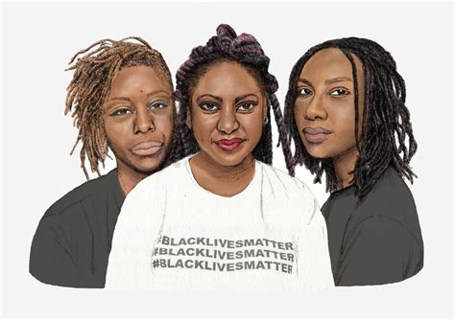
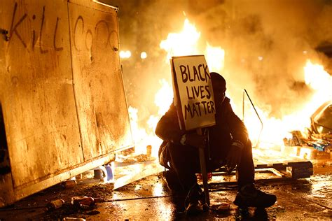
3. BLM: “New, improved” Ku Klux Klan?
3a. BLM, CRT and Marxism are inseparable
“In order to understand the cultural and historical context of #BlackLivesMatter, one must study it in terms of CRT.”
- from #BlackLivesMatter: A Collaborative Text https://www.ramapo.edu/scholarsweek/files/2015/08/Misha-Choudhry-SSHGS_2015.pdf
BLM co-founders Cullors, Garza, and Tometi.
Cullors and Garza self-identify as “trained Marxists”
A “mostly peaceful” protest

Slide 13
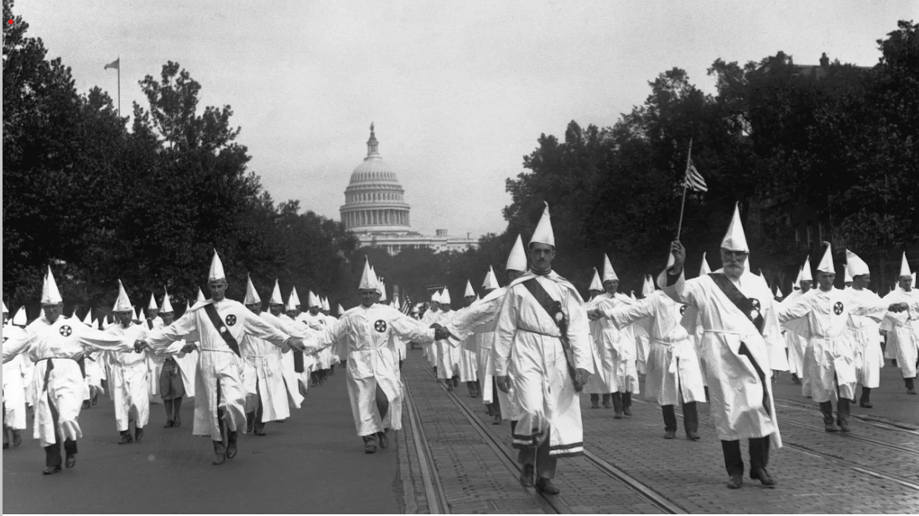
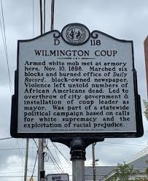
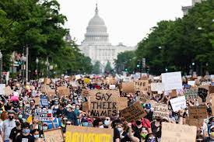
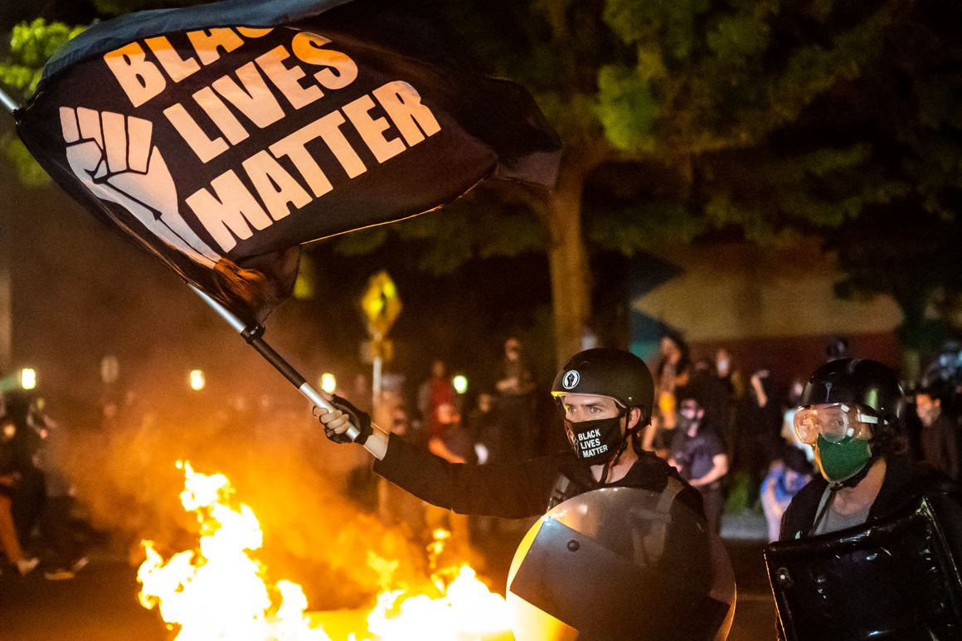
3b. CRT/BLM should remind us of the KKK
Old
racism,
20th
century
“New, improved”
Racism, 21st
century
A stolen 1898 North Carolina election at gunpoint and Wilmington murders led to Jim Crow
1925
Wilmington, NC 1898
Whites can’t be safe if they are “incurably evil”
2020
Portland, Oregon, 2020

Slide 14


4. Halting CRT
4a. Why is opposition so ineffective?
People fear doxxing, firing for speaking out (Amos 5:13); institutions become echo chambers
CRT claims criticism proves “racism”, “white fragility”, “unconscious bias”, “internalized white supremacy”
CRT false premise goes unchallenged: Our racist past indicates America was founded on racism (1619 Project)
4. Most dissenters attack CRT only in
theory but not the practical consequences at every level
You’re doxxed! You’re fired!

Slide 15
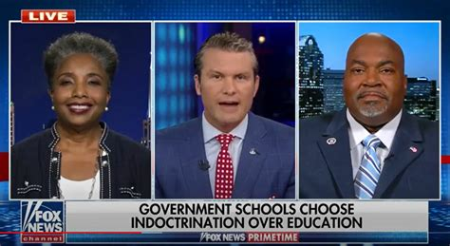

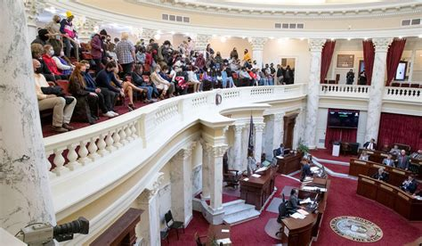
4b. Three successful anti-CRT strategies (1)
Government action
A) State legislation outlawing CRT in our institutions (schools, etc.)
B) Lawsuits: Against forced speech (1st Amendment), equal protection violations (14th Amendment), racial discrimination (1964 Civil Rights Act)
Dr. Carol Swain
(Vanderbilt, Ret.)
Lt. Gov. Robinson
(R-NC)
Interviewer
CRT banned, Idaho Senate, 2021

Slide 16
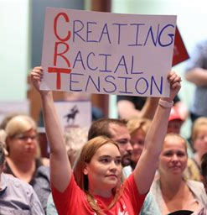
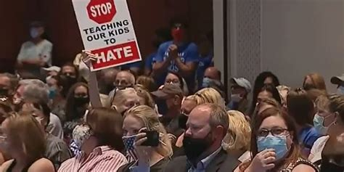
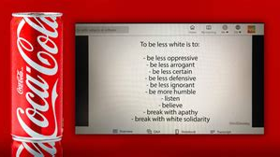
4b. Three successful anti-CRT strategies (2)
2. Grassroots mobilization
A) Full court press against lies
B) Parents resist school boards
C) Employees resist reeducation
D) Resist race essentialism, collective guilt, neo-segregation
E) Mao’s Cultural Revolution survivors insist: “Not in America!!”
Risus est bellum
(laughter is war)
Better, truthful slogans
Be a whistleblower?
Loudoun County, VA school board meeting

Slide 17
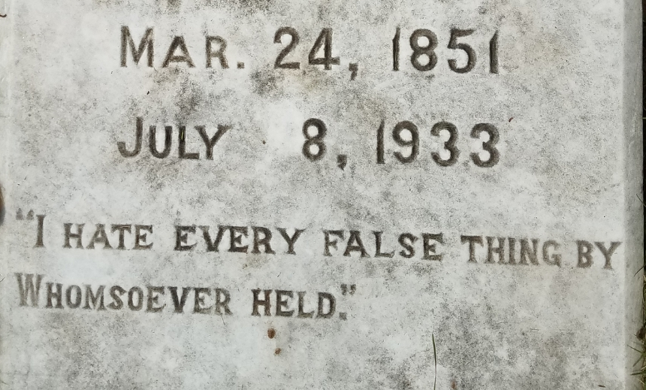
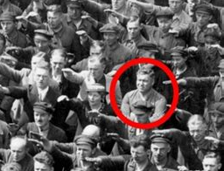
4b. Three successful anti-CRT strategies (3)
3. Appeal to principle
A) Refuse CRT’s stifling categories: Race does NOT determine all values, beliefs, practices, and lifestyles
B) Diversity may be good, but competence is indispensable
C) Don’t dismantle ideals because historic wrongs perverted them
D) Face the mobs, ignore the elites
E) Don’t be like far too many and cower when accused of “racism”
When they play the race card, DON’T EVER cower or retreat. Ad hominems
prove they just lost the argument!!
Name-calling is for school children, NOT for adults looking to solve problems.
Epitaph, Winston-Salem
Refused to “Sieg Heil!”

Slide 18
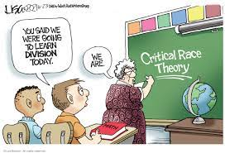
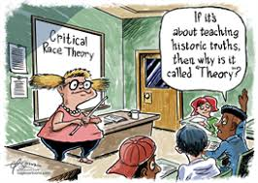

5. CRT is stupid! How did it ever thrive?? (1)

Slide 19
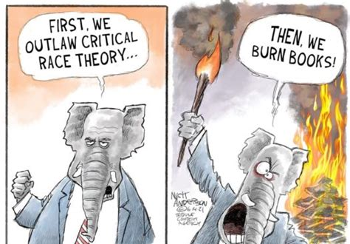
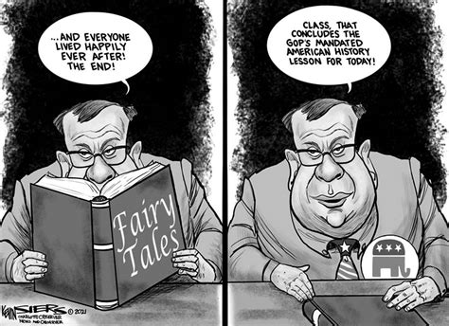
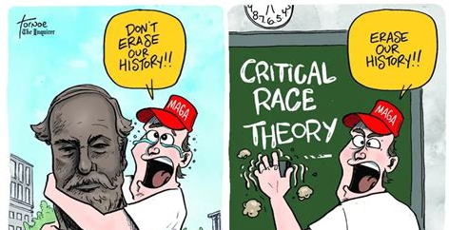
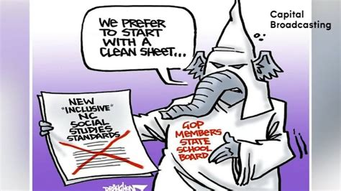
5. CRT is stupid! How did it ever thrive?? (2)
Straw man argu-ments against its critics

Slide 20
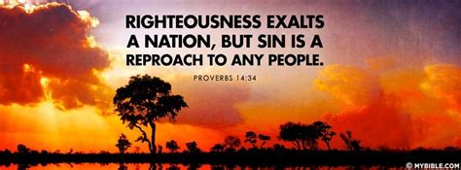
6. Sin, judgment, and repentance/restoration
6a. A sinful, wicked nation
“For the wrath of God is revealed from heaven against all ungodliness and unrighteousness of men, who by their unrighteousness suppress the truth.” (Romans 1:18)
“Hear the word of the Lord…There is no faithfulness or steadfast love, and no
knowledge of God in the land; there is swearing, lying, murder, stealing, and committing adultery; they break all bounds, and bloodshed follows bloodshed.”
(Hosea 4:1-2)
“[T]hey refused to love the truth and so be
saved. Therefore, God sends them a strong delusion, so that they may believe what is false, that all may be condemned who did not believe the truth but had pleasure in unrighteousness.” (2 Thessalonians 2:10b-11, emphasis added)

Slide 21
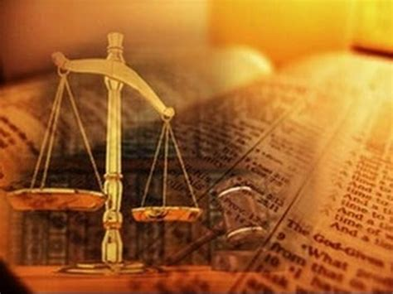
6b. Judgment on a wicked nation
“How could one chase a thousand,
two put ten thousand to flight, unless their Rock sold them, and the Lord
gave them up?” (Deuteronomy 32:30)
“I will set Egyptians against Egyptians;
everyone will fight his brother, against his neighbor, city against city, kingdom against kingdom. The spirit of Egypt will fail in its midst; I will destroy their counsel.” (Isaiah 19:2-3)
“You shall grope at noonday, as a blind man gropes in darkness; you shall not prosper in your ways; you shall be only oppressed and plundered continually, and no one shall save you.” (Deuteronomy 28:29)

Slide 22

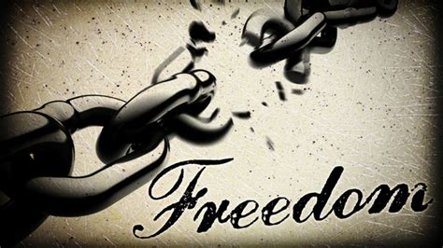
6c. Repentance/restoration
When I shut up heaven and there is no rain, or command the locusts to devour the land, or send pestilence among my people, if my people who are called by my name will humble themselves, and pray and seek my face, and turn from their wicked ways, then I will hear from heaven, and will forgive their sin and heal their land.” (2 Chronicles 2:13-14)
“Except the LORD build the house, they who build labor in vain” (Psalm 127:1)
Jesus promised freedom, but we’ll continue as slaves so long as we ignore sin, the true diagnosis (John 8:31-32). But CRT’s false diagnoses and remedies will only make our bondage worse.

