Slide 1

Pass HB 158

Slide 2
Table of Contents
I. Roe v. Wade violates both Constitutional and Divine law (3)
1. Constitutional law violated (4-8)
2. Divine law violated (9-13)
II. Brief overview of the ineffective "Pro-life" response (14-18)
1. Faulty thinking before Roe v. Wade (15)
2. Ineffective strategy since Roe v. Wade (16-19)
III. Let's learn from history! (20)
IV. A new strategy after 48 years’ failure (21-23)
1. Six Abolitionist tenets (22)
2. Five Abolitionist bill components (23)
V. State Constitutional Amendment HB 158 (24-27)
1. Pertinent HB 158 text (25)
2. Pro-life opposition to HB 158 (26)
3. Why do pro-life politicians oppose HB 158? (27)
VI. Hard Cases (28-31)

Slide 3
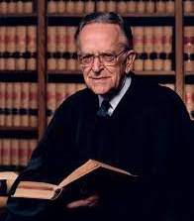
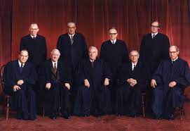
I. Roe v. Wade violates both Constitutional and Divine law
Seven unelected justices struck down
anti-abortion laws in all fifty States
Justice Blackmun, Roe’s author
Supreme Court that issued Roe v. Wade
(Justices White, Rehnquist dissented)

Slide 4

1. Constitutional law violated (1)
Federal legislative body: “All legislative Powers herein granted shall be vested in a Congress of the United States, which shall consist of a Senate and House of Representatives.” (Article 1, Section 1)
Note: All: The very first word after the Preamble!!
Federal legislative limitations: Congressional legislative power is limited to 18 powers (the Doctrine of Enumerated Powers) and does not include abortion (Article 1, Section 8)
Do judges make
law or discover it?
Roe v. Wade discovered law! Congress never “legalized” abortion!
The Federal Government keeps adding cars to the train.
And Roe v. Wade is one of the worst!

Slide 5
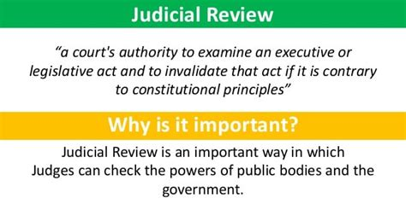
1. Constitutional law violated (2)
Further Federal legislative limitations: “The powers not delegated to the United States by the Constitution, nor prohibited by it to the States, are reserved to the States respectively, or to the people.” (10th Amendment) Roe was a power grab from the States
Article 3: Courts are to decide cases, not strike down laws
Marbury v. Madison: Extra-constitutional ruling that Courts can strike down unconstitutional laws; so what prevents another body from checking a court’s unconstitutional decisions?
As an exercise of raw judicial power, the Court perhaps has authority to do what it does today; but, in my view, its judgment is an improvident and extravagant exercise of the power of judicial review that the Constitution extends to this Court.
- Justice Byron White’s Dissent

Slide 6

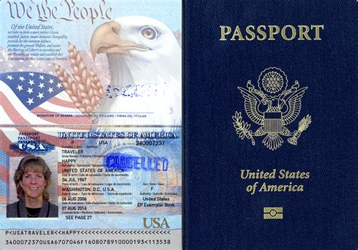
Roe v. Wade 410 U.S. 113 (1973):
The appellee and certain amici argue that the fetus is a "person" within the language and meaning of the Fourteenth Amendment...If this suggestion of personhood is established, the appellant's case, of course, collapses, for the fetus' right to life would then be guaranteed specifically by the Amendment…On the other hand...the appellee conceded on reargument that no case could be cited that holds that a fetus is a person within the meaning of the Fourteenth Amendment.
14th Amendment:
All persons born or naturalized in the United States, and subject to the jurisdiction thereof, are citizens of the United States and of the State wherein they reside…nor shall any State deprive any person of life, liberty, or property, without due process of law;
1. Constitutional law violated (3)
Roe v. Wade?
Who is a citizen? What is a person?

Slide 7


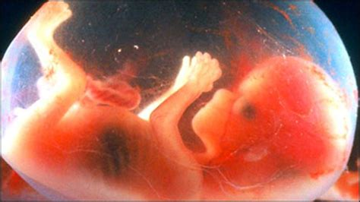
14th Amendment: Are the unborn neither citizens nor persons?
1. Constitutional law violated (4)
Noah Webster’s 1828 Dictionary’s primary definition of “Person”:
“An individual human being, consisting of body and soul. We apply the word to living beings only, possessed of a rational nature; the body when dead is not called a person…
http://webstersdictionary1828.com/Dictionary/person
1) “Living beings” clearly include unborn living beings but exclude corpses.
2) The 14th Amendment describes a citizen, not a person. It excludes unborn persons from citizenship, but if we are faithful to the authoritative dictionary when the 14th Amendment was written, we must understand “persons” to include the unborn.
Citizen? NO
Person? NO
Citizens? YES
Persons? YES
Citizen? NO
Person? YES!!

Slide 8
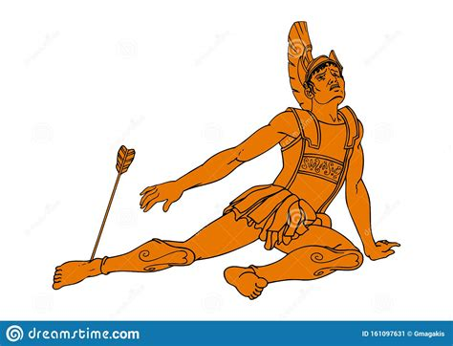

1. Constitutional law violated (5)
Because it redefines “person”, Roe v. Wade should be considered abortion’s Achilles’ heel, not “the law of the land”!
“The emperor has no clothes!”

Slide 9
2. Divine Law violated
Isaiah 10:1-3 applies also to the unborn child: “Woe to those who make unjust laws, to those who issue oppressive decrees, to deprive the poor of their rights and withhold justice from the oppressed of my people, making widows their prey and robbing the fatherless. What will you do on the day of reckoning, when disaster comes from afar? To whom will you run for help? Where will you leave your riches?” (emphasis added)
Poor, oppressed: Unborn child
Widows: A woman who undergoes her pregnancy alone: her “significant other”, while alive, abandons her
Fatherless: Unborn child whose father won’t save from death
Roe v. Wade sanctioned murder by denying the unborn child its personhood

Slide 10
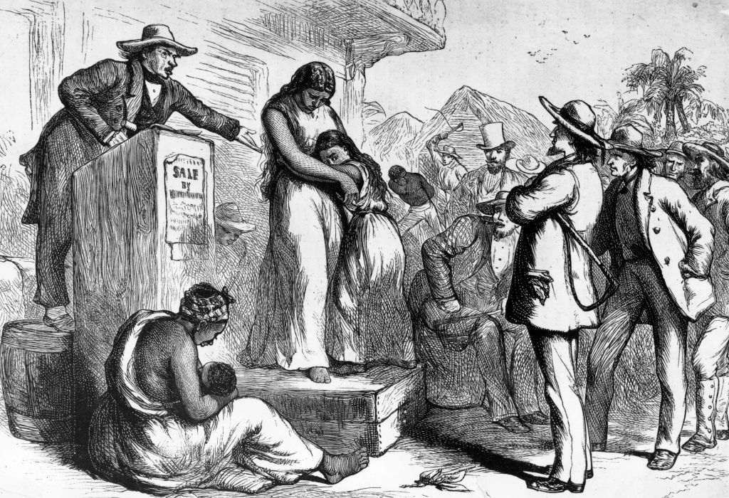
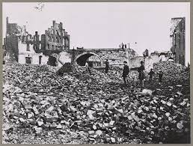
Denying personhood’s consequences (1)
Southern Negro slaves
Slave auction, antebellum South Richmond, VA 1865
“They’re not persons!” GOD IS NOT MOCKED

Slide 11
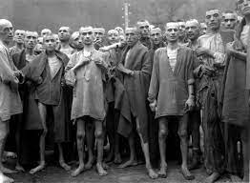
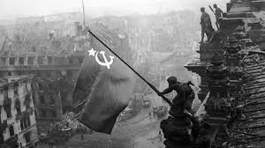
Denying personhood’s consequences (2)
Jews, Nazi Germany Berlin, 1945
“They’re not persons!” GOD IS NOT MOCKED

Slide 12
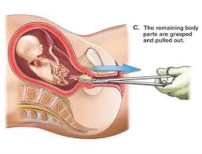

Denying personhood’s consequences (3)
Dilation and Evacuation
“She’s not a person!” GOD IS NOT MOCKED

Slide 13
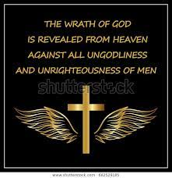
63 million murders and counting
“Shall I not punish them for these things? declares the Lord,
and shall I not avenge myself on a nation such as this?” (Jeremiah 5:29)

Slide 14
II. Brief overview of the ineffective "Pro-life" response
After 48 years and 63 million murders (and counting!)

Slide 15
“It has…been pointed out, n. 49, supra, that in Texas the woman is not a principal or an accomplice [to a crime] with respect to an abortion upon her. If the fetus is a person, why is the woman not a principal or an accomplice? Further, the penalty for criminal abortion specified by Art. 1195 is significantly less than the maximum penalty for murder prescribed by Art. 1257 of the Texas Penal Code. If the fetus is a person, may the penalties be different? (Roe v. Wade, Footnote 54)
Pro-life laws STILL don’t regard abortion as murder, which vitiates their effectiveness after Roe v. Wade
1. Faulty thinking before Roe v. Wade
The Texas law Roe v. Wade overturned gave SCOTUS an excuse

Slide 16
2. Ineffective strategy since Roe v. Wade
Elect Republican Presidents who will nominate “prolife” justices.
Hope these SCOTUS justices overturn Roe v. Wade (wait for Godot).
Work State by State to pass laws that acknowledge Roe so only regulate abortion (“you may kill some babies but not others”), hoping the courts won’t find them “unconstitutional”.
Pass laws in conservative States that directly challenge Roe, hoping SCOTUS will overturn it.
19 years after Roe (1992), this strategy failed with Planned Parenthood v. Casey. An “8-1 GOP Court” did not overturn Roe. Clinton was elected that November, and Democrats subsequently nominated 4 staunch pro-aborts.
29 years after Casey (2021-22), Jackson v. Dobbs will test this strategy again, with a 6-3 “GOP Court”, including 3 Trump appointees.
Will it work this time, 48 years and 63 million murders since Roe v. Wade?

Slide 17
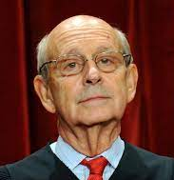

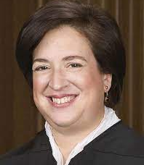
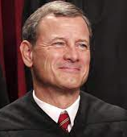
To reach a SCOTUS majority to overturn Roe v. Wade
Clinton and Obama appointees Breyer, Sotomayor, and Kagan are pro-Roe.
Chief Justice Roberts in 2020 provided the 5th vote to overturn a “pro-life” law in June Medical Services v. Russo, although in 2016 he had dissented in the similar Whole Women’s Health v. Hellerstedt. He concurred in June Medical:
"I joined the dissent in Whole Woman's Health and continue to believe that the case was wrongly decided. The question today, however, is not whether Whole Woman's Health was right or wrong, but whether to adhere to it in deciding the present case.“ (emphasis added)
Who expects Justice Roberts to vote to overturn Roe v. Wade?
Breyer Sotomayor Kagan Roberts

Slide 18
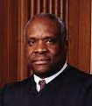
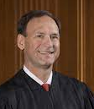
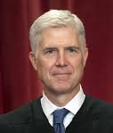
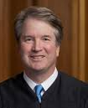
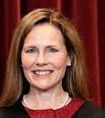
All five remaining justices (Thomas, Alito, Gorsuch, Kavanaugh, Barrett) must vote to strike down Roe. But: a) Only Justice Thomas, 73, has stated in an opinion that Roe v. Wade was unconstitutionally decided. No justice has joined him. b) The 5-4 majority in the recent Texas “heartbeat law” decision (Whole Woman’s Health v. Jackson) expressly did not affirm its constitutionality. c) Overturning Roe v. Wade will divide an already divided country, something the justices will be considering. A 5-4 decision would be even worse. d) If Roe is overturned, Biden will almost certainly try to pack the Court, and his majority would almost certainly “re-reverse” at earliest opportunity.
Thomas (b. 1948) Alito (b. 1950) Gorsuch Kavanaugh Barrett

Slide 19
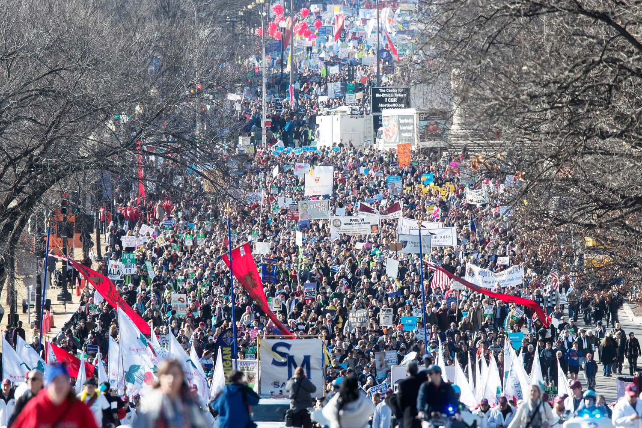
The massive “pro-life generation” army
pro-lifers don’t know how to lead!
What is to be done??

Slide 20
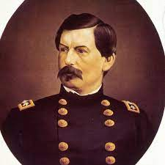
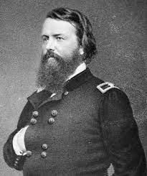
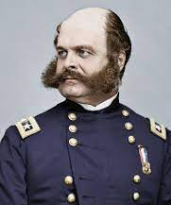
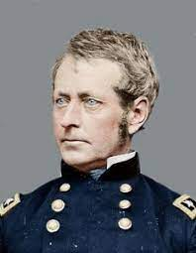
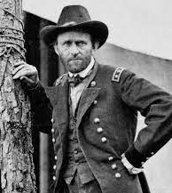
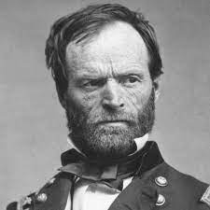
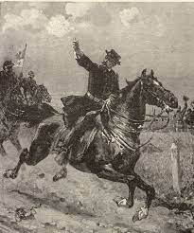
III. Let's learn from history!
Lincoln replaced these losing Civil War commanders…
McClelland
Pope
Burnside
Hooker
…and won the war with these winners!
Grant Sherman Sheridan

Slide 21

IV. A new strategy after 48-years’ failure
“Those who cannot remember the past are condemned to repeat it.”
– George Santayana
Let’s keep THIS from
happening over and over!

Slide 22
1. Six Abolitionist tenets
1) Abolish (don’t regulate) abortion vs. pro-life.
2) Biblical, not secular:
a) All abortions from conception murder an image-bearer of God;
b) Avoid political compromises: “You can kill these babies, as long as you don’t kill those babies” (iniquitous decrees, Isaiah 10:1)
c) Mobilize the Church: "Every abortion clinic should have a sign over the door that says, 'Open by permission of the churches in this area.’” (Francis Schaeffer).
3) Immediatist (Bible is supreme) vs. gradualist (SCOTUS is supreme)
4) No exceptions: Both rape and abortion are violent invasions; neither is justified.
5) Ignore Roe v. Wade.
6) Criminalize everyone directly involved as a murderer or an accomplice.

Slide 23

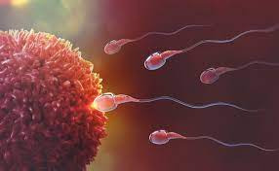

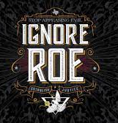

2. Five Abolitionist bill components
1) All abortions are murder.
2) Outlaws all abortions from conception.
3) No exceptions, including rape and incest.
4) Ignores unconstitutional court opinions and judicial review.
5) Repeals and supersedes all existing “pro-life” gradualist laws.
1) 2) 3) 4) 5)

Slide 24
IV. State Constitutional
Amendment HB 158

Slide 25
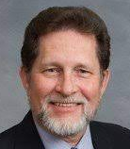
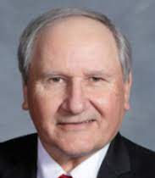
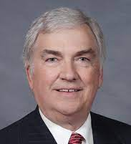
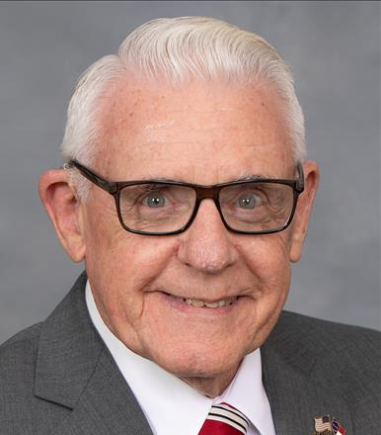

1. Pertinent HB 158 text:
“Life begins at fertilization. It is a matter of indisputable scientific fact that a distinct and separate human life begins at the moment of fertilization…Any person who willfully seeks to destroy the life of another person, by any means, at any stage of life, or succeeds in doing so, shall be held accountable for attempted murder or for first degree murder, respectively…The State has an interest and a duty to defend innocent persons from willful destruction of their lives and to punish those who take the lives of persons, born or unborn, who have not committed any crime punishable by death.”
Sponsored by 5 State House Representatives:
Larry Pittman Mark Brody Jay Adams George Cleveland Keith Kidwell
Cabarrus Union, Anson Catawba Onslow Beaufort, Craven

Slide 26
2. Pro-life opposition to HB 158 in 2021
Feb. 24: Rep. Pittman filed HB 158.
Feb. 25: Referred to the Committee on Judiciary 1.
June 30: Rep. Pittman filed a discharge petition.
July 13: Speaker Moore withdrew HB 158 from Committee on Judiciary 1 (voiding the discharge petition).
July 13: Referred to the Committee on Families, Children, and Aging Policy.
August 4: Rep. Pittman filed a discharge petition.
August 4: Speaker Moore withdrew HB 158 from the Committee on Families, Children, and Aging Policy.
August 4: Referred to the Committee on Judiciary 2.

Slide 27
Why do pro-life politicians oppose HB 158?
Keep HB 158 off the State House floor, so “pro-life” representatives won’t be forced to vote for or against abolition (and risk losing Right to Life NC endorsement?)
Meanwhile, push for “incrementalist” bills to “prove” to their (mostly Christian) pro-life constituents they really are hard at work against abortion.
Use the Right to Life movement as “get out the vote” foot soldiers for Republican Party “pro-lifers”.
Laugh at all the gullible Christians who keep reelecting their “heroes”.

Slide 28
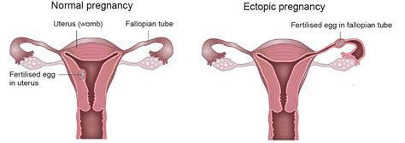
VI. Hard Cases
1. What about ectopic pregnancies?
Embryo fails to implant in the uterus (usually in a fallopian tube)
Embryo cannot live because it cannot grow to term
Embryo cannot be reimplanted in the uterus (as of now)
The mother will die unless the embryo is surgically or chemically removed
An ectopic pregnancy termination not an abortion
Abolitionists falsely accused of preventing removal of the embryo, forcing women to die

Slide 29
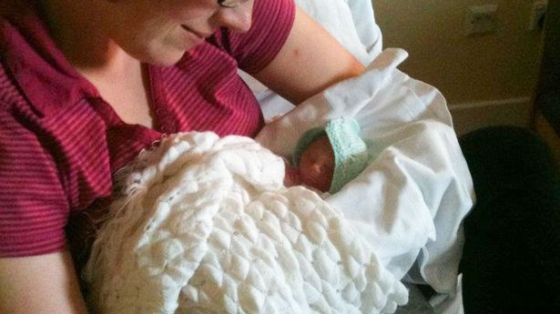
2. What if the baby won’t survive outside the womb?
Birth defects typically detected during the 2nd trimester
What if a child is diagnosed as not able to survive after birth?
a) Does HB 158 allow the parents to have labor induced? b) Does HB 158 force the woman to carry the child to term?
Baby’s lungs not developing at 21 weeks
Should it be a crime for her to induce labor?

Slide 30

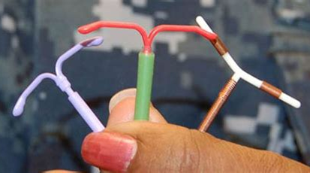
3. What about contraceptives? (1)
If “Life begins at fertilization…” (HB 158):
Since some contraceptives (“the Pill”, IUD, etc.) do not always prevent
fertilization, they also prevent a fertilized egg from implanting.
Will HB 158 make them illegal?

Slide 31
3. What about contraceptives? (2)
Pope Paul VI, Papal Encyclical Humane Vitae, 1968:
12. “…the two meanings of the conjugal act: the unitive meaning and the procreative meaning.”
17. “Upright men can even better convince themselves of the solid grounds on which the teaching of the Church in this field is based, if they care to reflect upon the consequences of methods of artificial birth control. Let them consider, first of all, how wide and easy a road would thus be opened up towards conjugal infidelity and the general lowering of morality.” https://www.vatican.va/content/paul-vi/en/encyclicals/documents/hf_p-vi_enc_25071968_humanae-vitae.html
Humane Vitae proscribes contraceptives. But just as the Pope warned, we separated sex’s unitive from the procreative, and prized our “right” to have sex without producing children. When an unwanted pregnancy foils the contraceptive effort, abortion has become a “wide and easy a road”.

