Slide 1
Should Deaconesses be Ordained?
John E. Taylor
Mooresville, NC
December 1, 2023

Slide 2
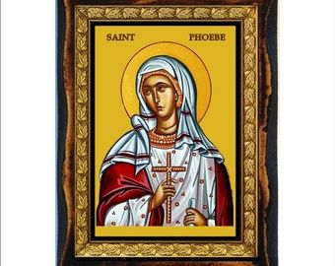
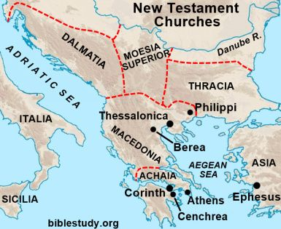
1. Does Scripture recognize deaconesses?
1a. Yes! Phoebe was a deaconess (Διάκονον, Rom. 16:1)
Διάκονον is translated elsewhere as “deacon” (Phil. 1:1, 1 Tim. 3:8)
We know very little about her.
She was a member of the
church at Cenchrea (Rom. 16:1)
She was among those who
delivered Paul’s letter to
the Romans.
She was on an unnamed
Overseas mission.
Rome

Slide 3

1b. What did Paul ask the church in Rome to do for her?
“That you
1) receive her in the Lord, as becomes saints, and that you
2) assist her in whatever business she has need (χρῄζῃ) of you.” (Rom. 16:2)
“Need” (χρῄζῃ) is not “require”. The one with authority here is Paul, not Phoebe
Is Paul expecting the Romans to do more for her than they would any unordained single women sent on a mission?

Slide 4



Isn’t this precisely the kind of women (single or unmarried) we send overseas on missions? And honor in our churches?
As a minimum, she had earned the title “deaconess” for her services.
But was she ordained?
1c. Why did Paul ask the Roman church to help her?
“She has been a helper of many, and of me also.” (Rom. 16:2)

Slide 5



2. What is a deacon? (διάκονος)
From Strong’s #1249 διακονos, diákonos:
One who executes the commands of another, esp. of a master, a servant, attendant, minister
Do deacons execute God’s commands? Or those who ordain them?

Slide 6

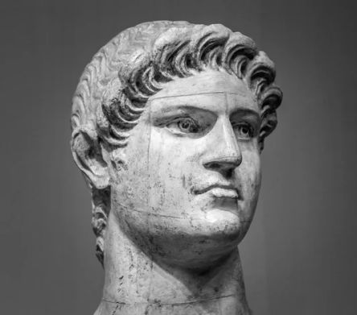
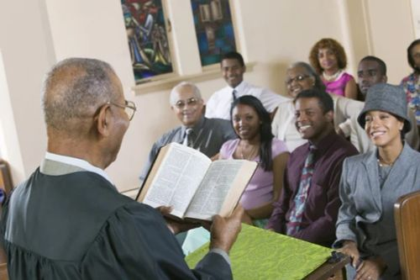
2a. Examples of Διάκονοs (servants) in the NT
Those great among us must serve (Mt. 23:1, 11)
Mary’s sister Martha served (Lk. 10:40, Jn. 12:2)
Jesus’ followers are His servants (Jn. 12:26)
Rulers from Nero on down are God’s servants (Rom. 13:4)
Christ was a servant to the Jews (Rom. 15:8)
Paul and other ministers were servants (1 Cor. 3:5)

Slide 7
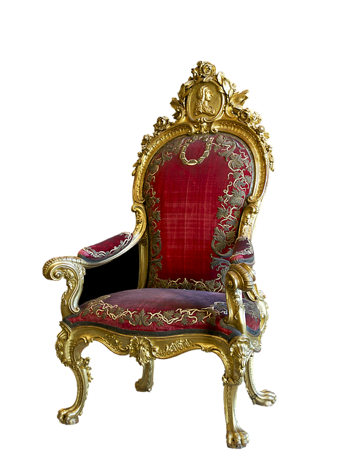
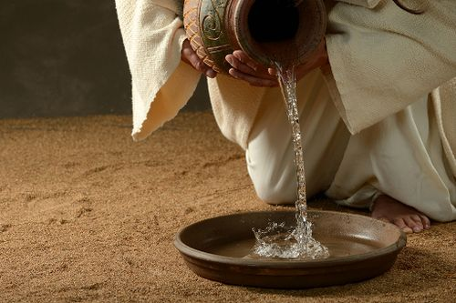

2b. So what does a Διακόνους (m.) or Διάκονον (f.) do?
They are exemplary at serving others
a) Perform lowly tasks
b) May rule others
c) May be an apostle or minister
They may be male or female

Slide 8




3. Was Phoebe Ordained? (καταστήσῃς)
3a. Who can doubt God is binary?
Day or night
Land or sea
Plant or animal
Male or female
Heaven or hell
God either wants
ordained deaconesses…
Or He doesn’t!

Slide 9


3b. How long will we waver between two opinions?
(cf. 1 Kn. 18:21)
If God wants ordained deaconesses, not ordaining them robs them of effectiveness in the church.
If God does not want ordained deaconesses, ordaining them harms them, the office, and the church.
“Agreeing to disagree” divides the church.
Should we pray “God, we will not let You go until You give us agreement on this matter”? (cf. Gen. 32:26)

Slide 10
3c. Prayer regarding this matter (Prov. 2:1-6)
“My son, if you receive my words, And treasure my commands within you,
(Treasure the Scripture above all else)
² So that you incline your ear to wisdom, And apply your heart to understanding;
(Seek good arguments, reject bad arguments for both sides (including here!)
³ Yes, if you cry out for discernment, And lift up your voice for understanding,
(Be sufficiently vexed by the division to cry aloud to God about it)
⁴ If you seek her as silver, And search for her as for hidden treasures;
(Turn that vexation into dogged pursuit of Truth until it is found)
⁵ Then you will understand the fear of the Lord, And find the knowledge of God.
(Fear God more than the wrath of man)
⁶ For the Lord gives wisdom; From His mouth come knowledge and understanding;”
(Cling to God’s promise no matter how long it takes)
How beautiful the sight of brethren who agree (Ps. 122:1)

Slide 11

4. How is καταστήσῃς and its cognates used in the NT?
(Strong's #2525 καταστήσῃς: to designate, appoint, ordain)
Paul and Barnabas ordained elders in every church (Acts 14:23, KJV)
Paul commanded Titus to ordain elders in every city (Tit. 1:5, KJV)
Choose seven men…whom we may appoint over this business (Acts 6:3)
Pharaoh made Joseph governor over all Egypt (Acts 7:10)
Now Joshua son of Nun was filled with the spirit of wisdom because Moses had laid his hands on him. So the Israelites listened to him and did what the Lord had commanded Moses (Deut. 34:9; see also Num. 27:20, “Give him some of your authority”).
Choose seven men from among you…They chose [seven men and]…presented them to the apostles, who prayed and laid their hands on them. (Acts 6:3, 5-6)

Slide 12
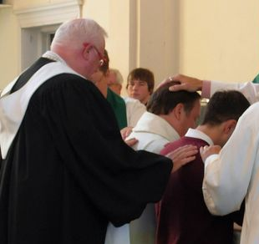
4a. Ordination constitutes transfer of authority
That authority comes from laying on of hands; Moses gave some of his authority to Joshua (Deut. 34:9; see also Num. 27:20).
The authority therefore does not come directly from God, as did Moses’ and the Twelve’s authority)
The Apostles at the first were responsible for the feeding the Greek-speaking widows.
All church contributions were laid at the Apostles’ feet (Acts 4:37, 5:2), giving them the authority to spend it.
They transferred both the responsibility and the authority for caring for the widows to the Seven by laying on of hands.

Slide 13


4b. Did Phoebe have ordained authority?
Paul forbids female authority over men in the church (1 Tim. 2:12).
Ordained deacons decide how much diaconal money to distribute to male heads of households. How does that not constitute authority?
The seven chosen to help the widows were men (Acts 6:3).
How do female deacons with authority over men not undermine male headship, hinder their wives’ respect for them (Eph. 5:33)? Is that not indecent and disorderly (1 Cor. 14:40)?
Phoebe had a title “deaconess” in the Cenchreae church. She was exemplary in providing services (something required of every Christian), and she needed assistance on a mission trip to Rome (Rom. 16:1-2).
How do we deduce that Paul recognized Phoebe as having ordained authority, either in Cenchreae or in Rome?

Slide 14
How does lack of ordination unbiblically limit a woman’s service?
5. If deaconesses may be ordained but are not…
6. If deaconesses may not be ordained…
How would loss of ordination hinder their service to the church?

